Slide 1
New National Curriculum For Maths and Methods: KS2
By Mrs Grasby, Maths Leader, 2016

Slide 2
Aims:
To make parents more familiar with the New Mastery Curriculum for Mathematics and our use of a Mastery Approach to teaching Maths (including Growth Mindset).
2. To inform parents of changes to Assessment (including new KS2 SATS).
3. To enable parents to better support their child’s mathematical development at home. Increase understanding of : Methods, Language used and how to enable your child (and you) to develop a ‘Growth Mindset’.

Slide 3

National Curriculum
Key messages
The expectation is that the majority of pupils will move through the programmes of study at broadly the same pace.
However, decisions about when to progress should always be based on the security of pupils’ understanding and their readiness to progress to the next stage.
Pupils who grasp concepts rapidly should be challenged through being offered rich and sophisticated problems before any acceleration through new content.
Those who are not sufficiently fluent with earlier material should consolidate their understanding, including through additional practice, before moving on. National Curriculum 2014
00/00/2013
Your Name
Notes:
POS describes what is to be taught but decisions about delivery and organisation remain with individual schools.
Arranged year on year –but some flexibility as to when content is taught within each key stage

Slide 4

What is a Mastery Curriculum?
What is a Mastery Approach?
Mastery is something that we want pupils to acquire. All pupils.
The Government has designed a new ‘mastery Maths curriculum’ and recommends that schools adopt a ‘Mastery Approach’ to teaching Maths.
A Mastery Curriculum and a Mastery Approach to teaching both have the same aim—to help pupils, over time, acquire mastery of the subject.

Slide 5
Three Elements Of Mastery
Reason mathematically
Mastery of Maths means a deep, long-term, secure and adaptable understanding of the subject. Three elements of Mastery:
Problem solving and using and applying in context
Fluency with conceptual
understanding
00/00/2013
Your Name
Notes:
Spend time looking at this diagram and explaining these over arching aims.
Staff who go directly to the POS for their year group will miss be misled and thin k it is all about formal calculations and fractions!

Slide 6
Mastery of maths, which should build gradually as a child goes through school, is a tool for life, and immeasurably more valuable than the short term ability to answer questions in tests or exams.
Is mastery new? There’s nothing new about the desire among teachers to help children develop deep understanding of the subject. But the word ‘Mastery’ in relation to Maths teaching and Maths learning is relatively new in the UK.
The old curriculum was about assigning ‘best fit’ levels to children and would allow children to progress through the curriculum with some gaps and without deeper learning and understanding.

Slide 7
IMPLICATIONs OF A MASTERY APPROACH
Move away from labelling pupils as ‘high ability’ or ‘low ability’ and instead give them different tasks and allowing the children to self select these tasks on a lesson to lesson or task to task basis depending on their current level of understanding within that Mathematical concept.
Children need to develop a Growth Mindset- curriculum is harder and all need to ‘master’ everything. Children need to develop: independence, perseverance, resilience and belief that they can grow their brains!
3. Reduce the amount of mathematical topics handled in class, but increase the depth and take longer over each one, so that understanding is cemented more sustainably.
Children no longer study every Maths topic three times a year as in the old Curriculum. Most topics in Key stage 2 are now in 2-6 week blocks. KS2 teachers follow this rough cycle: Place Value, Calculation (+, _, x, ./.), Fractions (including decimals and percentages), Measures, Geometry, Statistics. In year 5/6 children also study Ratio and Algebra.
More detailed explanations of the NCETM’s thinking in this developing area can be found in several recent posts on the blog page of our Director, Charlie Stripp, and in an earlier NCETM paper from autumn 2014.

Slide 8
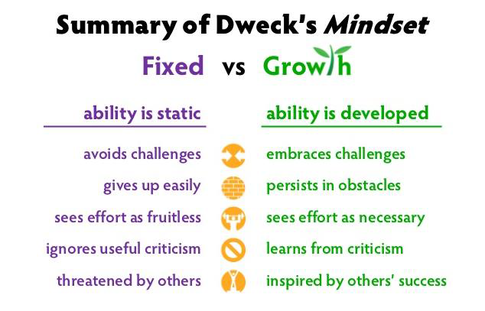
https://www.youtube.com/watch?v=wh0OS4MrN3E

Slide 9
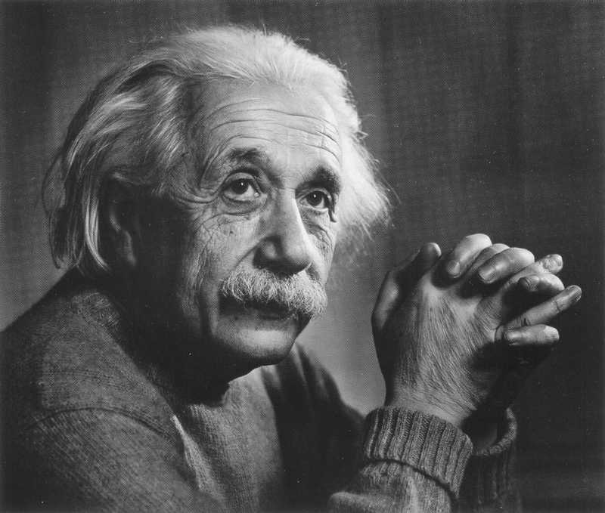
‘I think and think for months and years. Ninety nine times out of a hundred I am wrong. The hundredth time I am right.’
Albert Einstein
https://www.youtube.com/watch?v=JA7G7AV-LT8

Slide 10


Slide 11
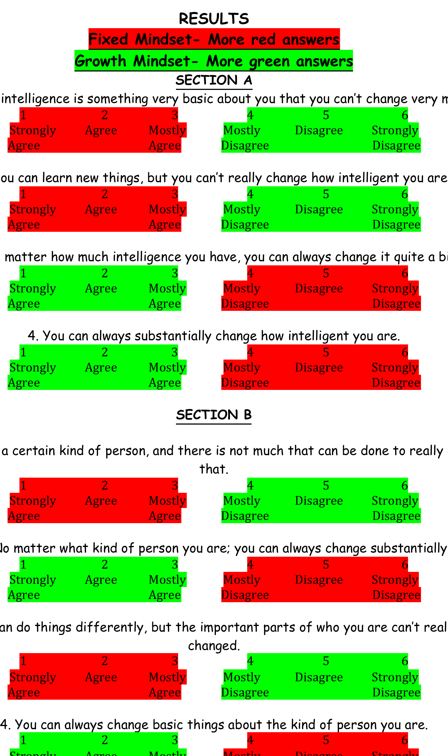

Slide 12
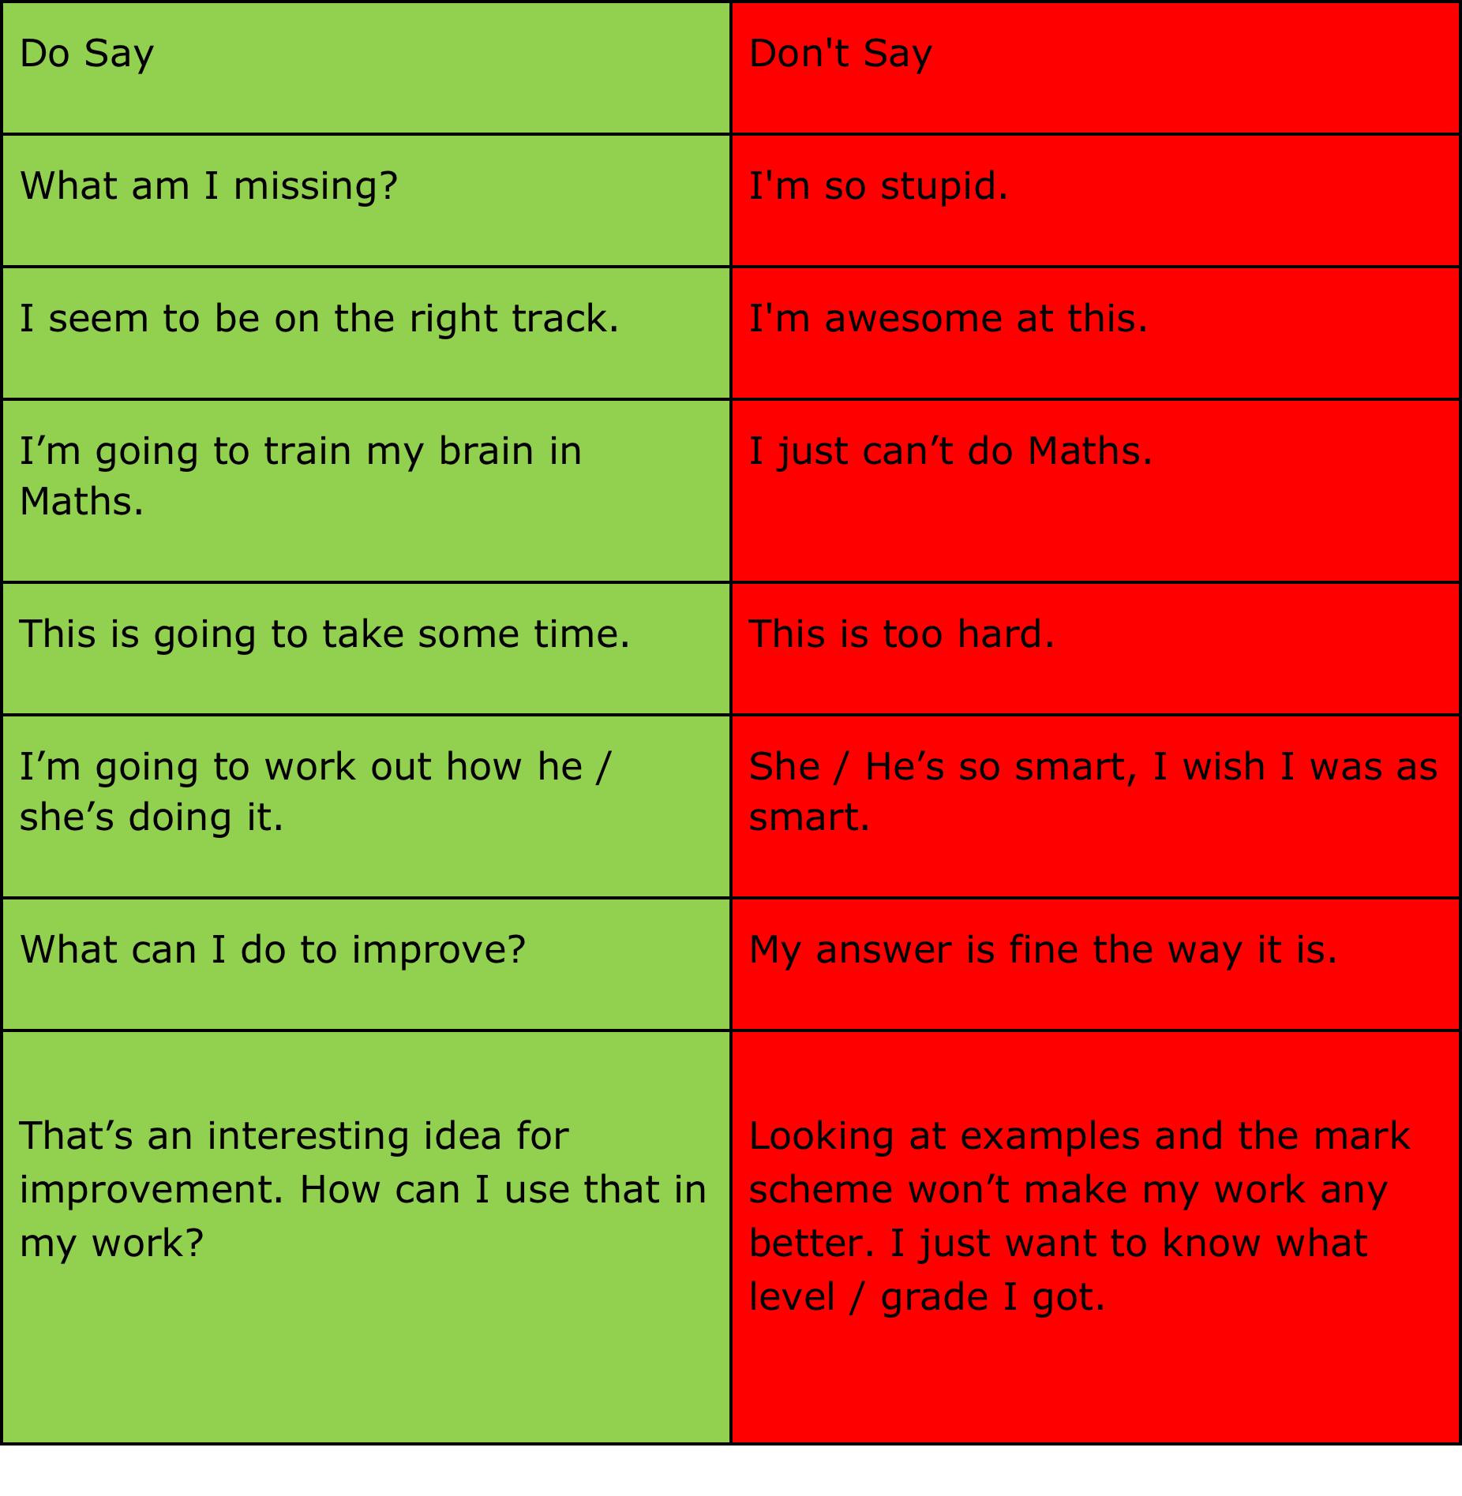
CHANGE THE LANGUAGE YOU USE AT HOME!
Model a Growth Mind-Set
Show your children how to recognise fixed mind-set thoughts, how to stop them, and how to replace them with growth mind-set thoughts.
Make the rule that fixed mind-set thoughts spoken aloud in your home will be stopped (including by you!) and the child will need to rephrase the idea as a growth mind-set thought, by doing so you will help your child recognise fixed mind-set thoughts. You will also help children monitor each otherand shift their thoughts toward growth.

Slide 13




Slide 14
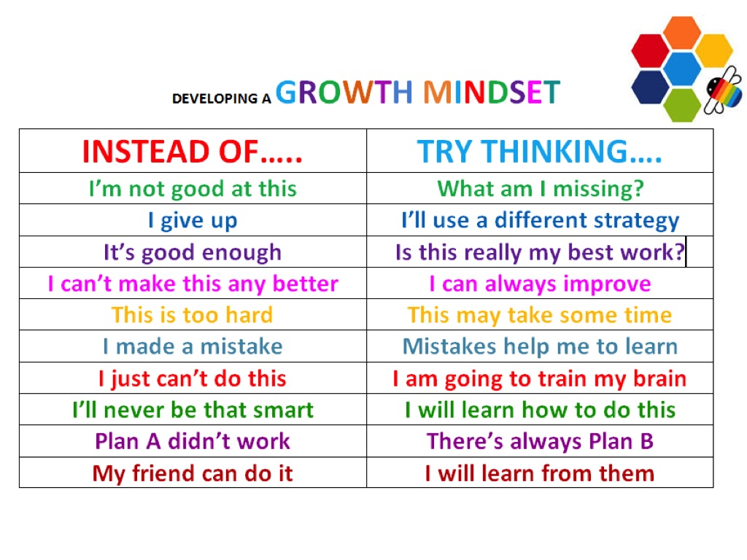

Slide 15
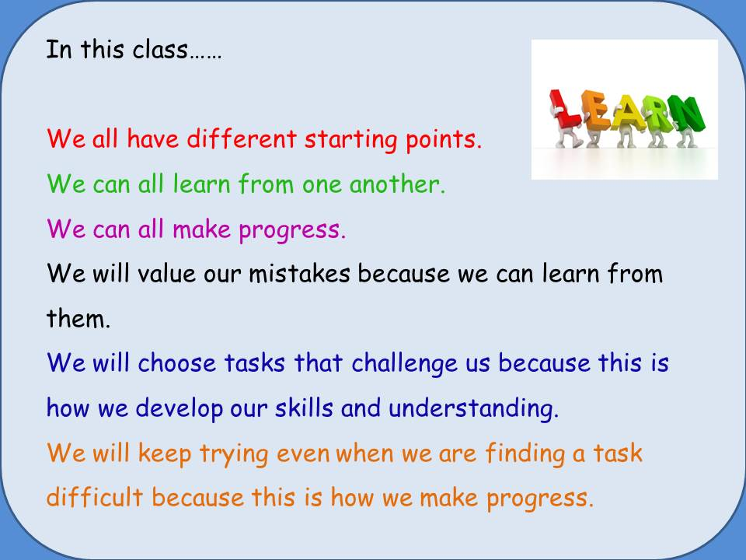

Slide 16
Mastery Approach to Teaching Maths
:
Questioning and scaffolding vary, different problems to solve, higher attainers within an area are given complex problems which deepen their knowledge of the same content. Misconceptions dealt with immediately.
Fluency comes from deep knowledge and practice. Ability to recall facts and manipulate them to work out other facts is important.

Slide 17
Designing purposeful learning for mathematics- Intelligent Practice
Exploring
Using diennes, hundred squares, recording on number lines
23 + 30 = o
23 + o = 54
23 + 30 = o
23 + o = 52
23 + o = 51
53 + o = 93
53 + o = 92
53 + o = 91
44 + 38 = o
23 + 10 =
23 + 11 =
23 + 12 =
23 + 20 =
23 + 21 =
23 + 22 =
23 + 30 =
23 + 31 =
23 + 32 =
Aspect of mathematical learning:
Add a number near to a multiple of 10.
Purpose
Explore and clarify
23 + 10 =
23 + 9 =
23 + 8 =
23 + 20 =
23 + 19 =
23 + 18 =
23 + 30 =
23 + 29 =
23 + 28 =
Clarifying
Teacher – directed
what’s the same? What’s different between the representations of the same problem?
What’s changed? What’s stayed the same between each step? What do you notice?
Notes:
Exploring:
Use of diennes
Numberline / 100 square
What’s the same? What’s different?
Where are the pivot points?
What next?
Clarifying
Teacher – directed – questioning – what’s the same? What’s different between the representations of the same problem?
What’s changed? What’s stayed the same between each step? What do you notice?
Refer to the NCETM article included in the pack

Slide 18
INTELLIGENT PRACTICE OF MULTIPLICATION AND DIVISION FACTS
 | 1 | 2 | 3 | 4 | 5 | 6 | 7 | 8 | 9 | 10 | 11 | 12
1 | 1 | 2 | 3 | 4 | 5 | 6 | 7 | 8 | 9 | 10 | 11 | 12
2 | 2 | 4 | 6 | 8 | 10 | 12 | 14 | 16 | 18 | 20 | 22 | 24
3 | 3 | 6 | 9 | 12 | 15 | 18 | 21 | 24 | 27 | 30 | 33 | 36
4 | 4 | 8 | 12 | 16 | 20 | 24 | 28 | 32 | 36 | 40 | 44 | 48
5 | 5 | 10 | 15 | 20 | 25 | 30 | 35 | 40 | 45 | 50 | 55 | 60
6 | 6 | 12 | 18 | 24 | 30 | 36 | 42 | 48 | 54 | 60 | 66 | 72
7 | 7 | 14 | 21 | 28 | 35 | 42 | 49 | 56 | 63 | 70 | 77 | 84
8 | 8 | 16 | 24 | 32 | 40 | 48 | 56 | 64 | 72 | 80 | 88 | 96
9 | 9 | 18 | 27 | 36 | 45 | 54 | 63 | 72 | 81 | 90 | 99 | 108
10 | 10 | 20 | 30 | 40 | 50 | 60 | 70 | 80 | 90 | 100 | 110 | 120
11 | 11 | 22 | 33 | 44 | 55 | 66 | 77 | 88 | 99 | 110 | 121 | 132
12 | 12 | 24 | 36 | 48 | 60 | 72 | 84 | 96 | 108 | 120 | 132 | 144
Multiples of 4
are double of
multiples
Of 2
Square numbers
Double 3s for 6s
Double 6s for 12s
Commutativity
Double 4s for 8s

Slide 19
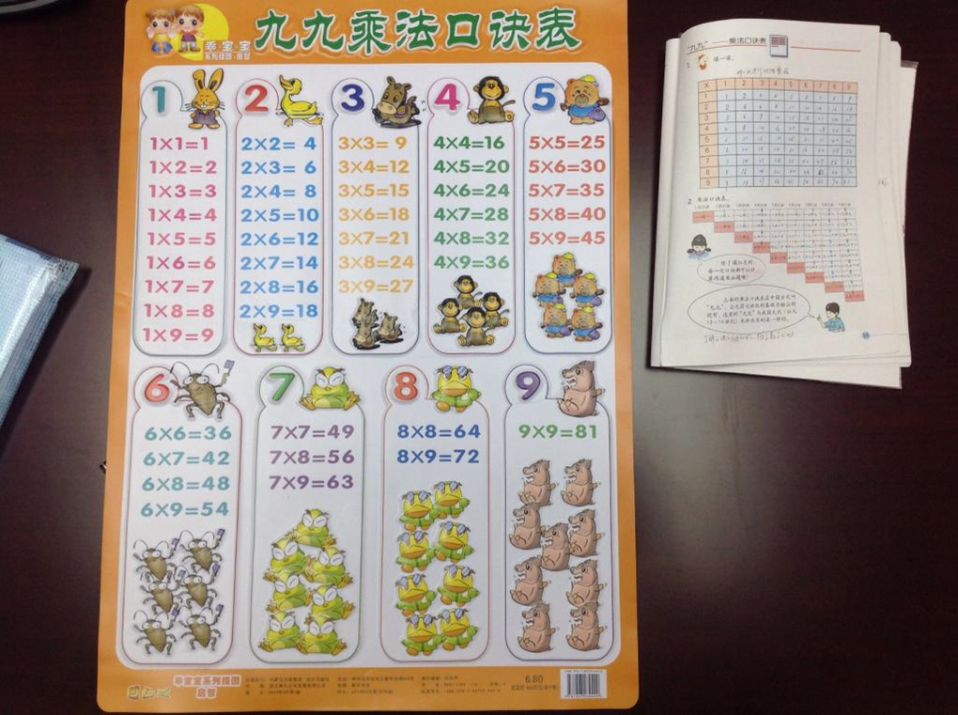

Slide 20
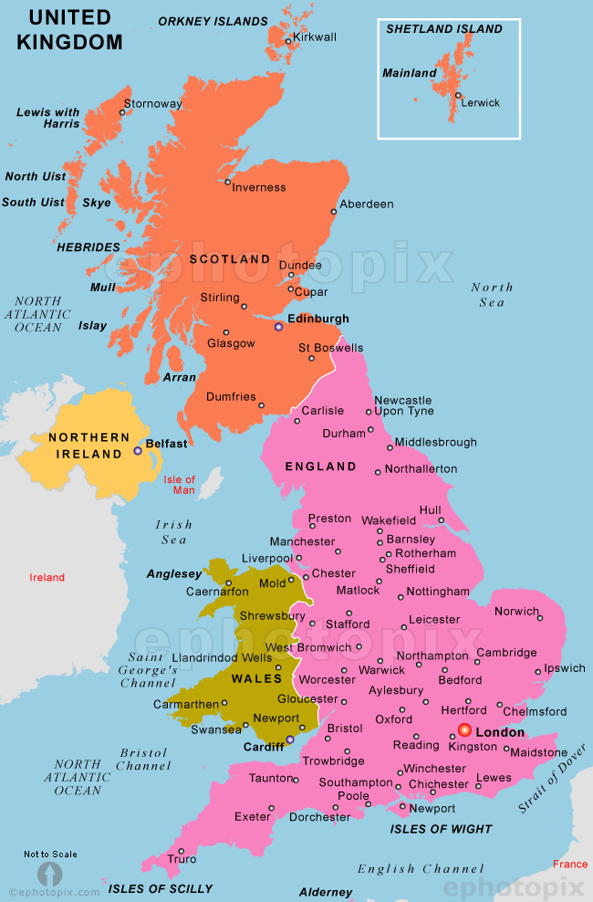
The first thing children need to know...
Mastery Approach to teaching- fractions
Whole...part relationship
The UK is the whole....
England is the part

Slide 21

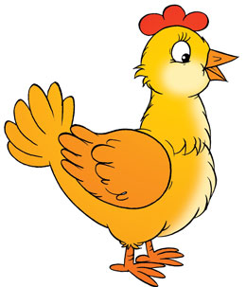
Mastery Approach to teaching- fractions
What is the whole/part relationship here?

Slide 22
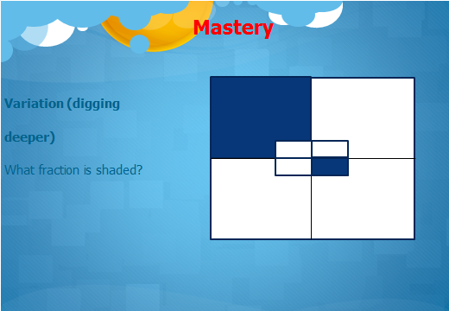

Slide 23
Variation (digging even deeper)
What fraction is shaded?
What fraction is each part?
Working within POS in greater depth (exceeding)

Slide 24
Working Within Greater Depth:
Andy’s Marbles
https://nrich.maths.org/2421

Slide 25
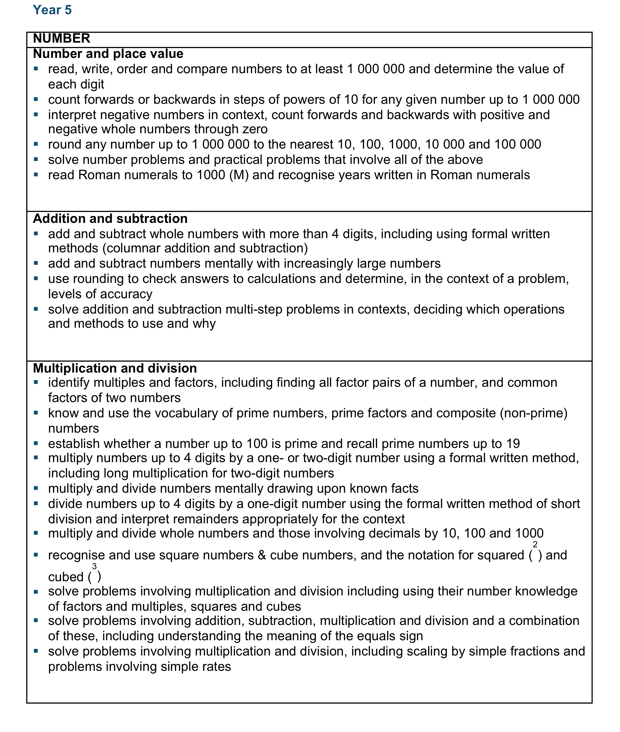
New year 5 POS
Pages like this for every year group

Slide 26
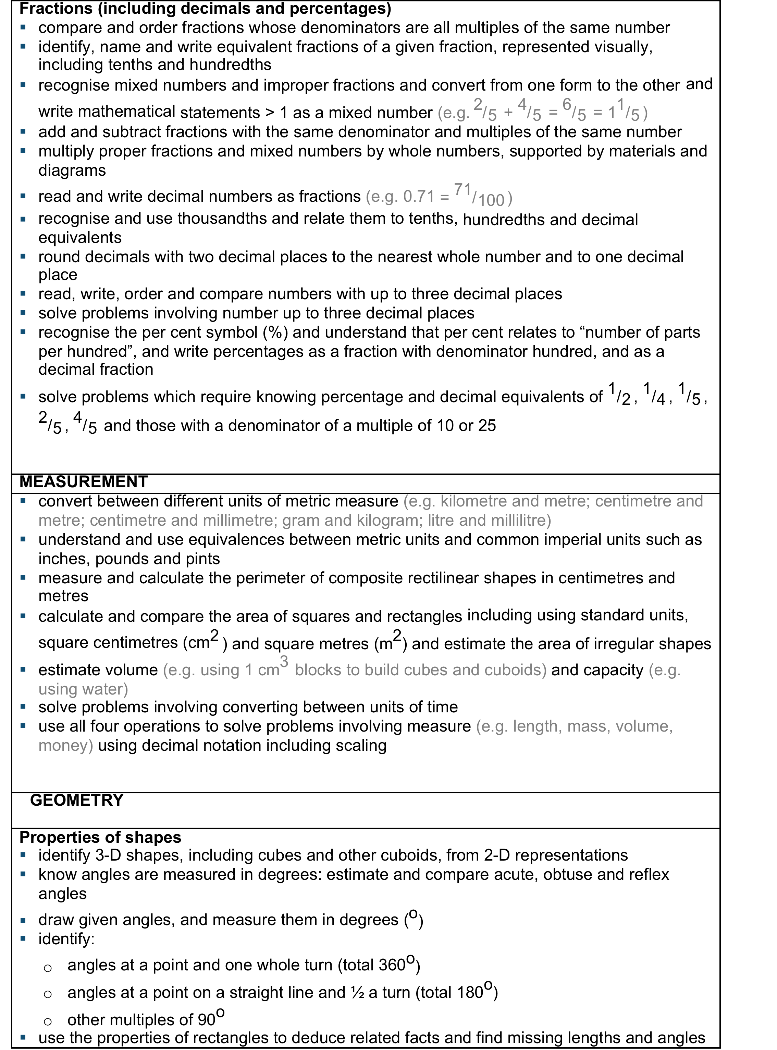

Slide 27
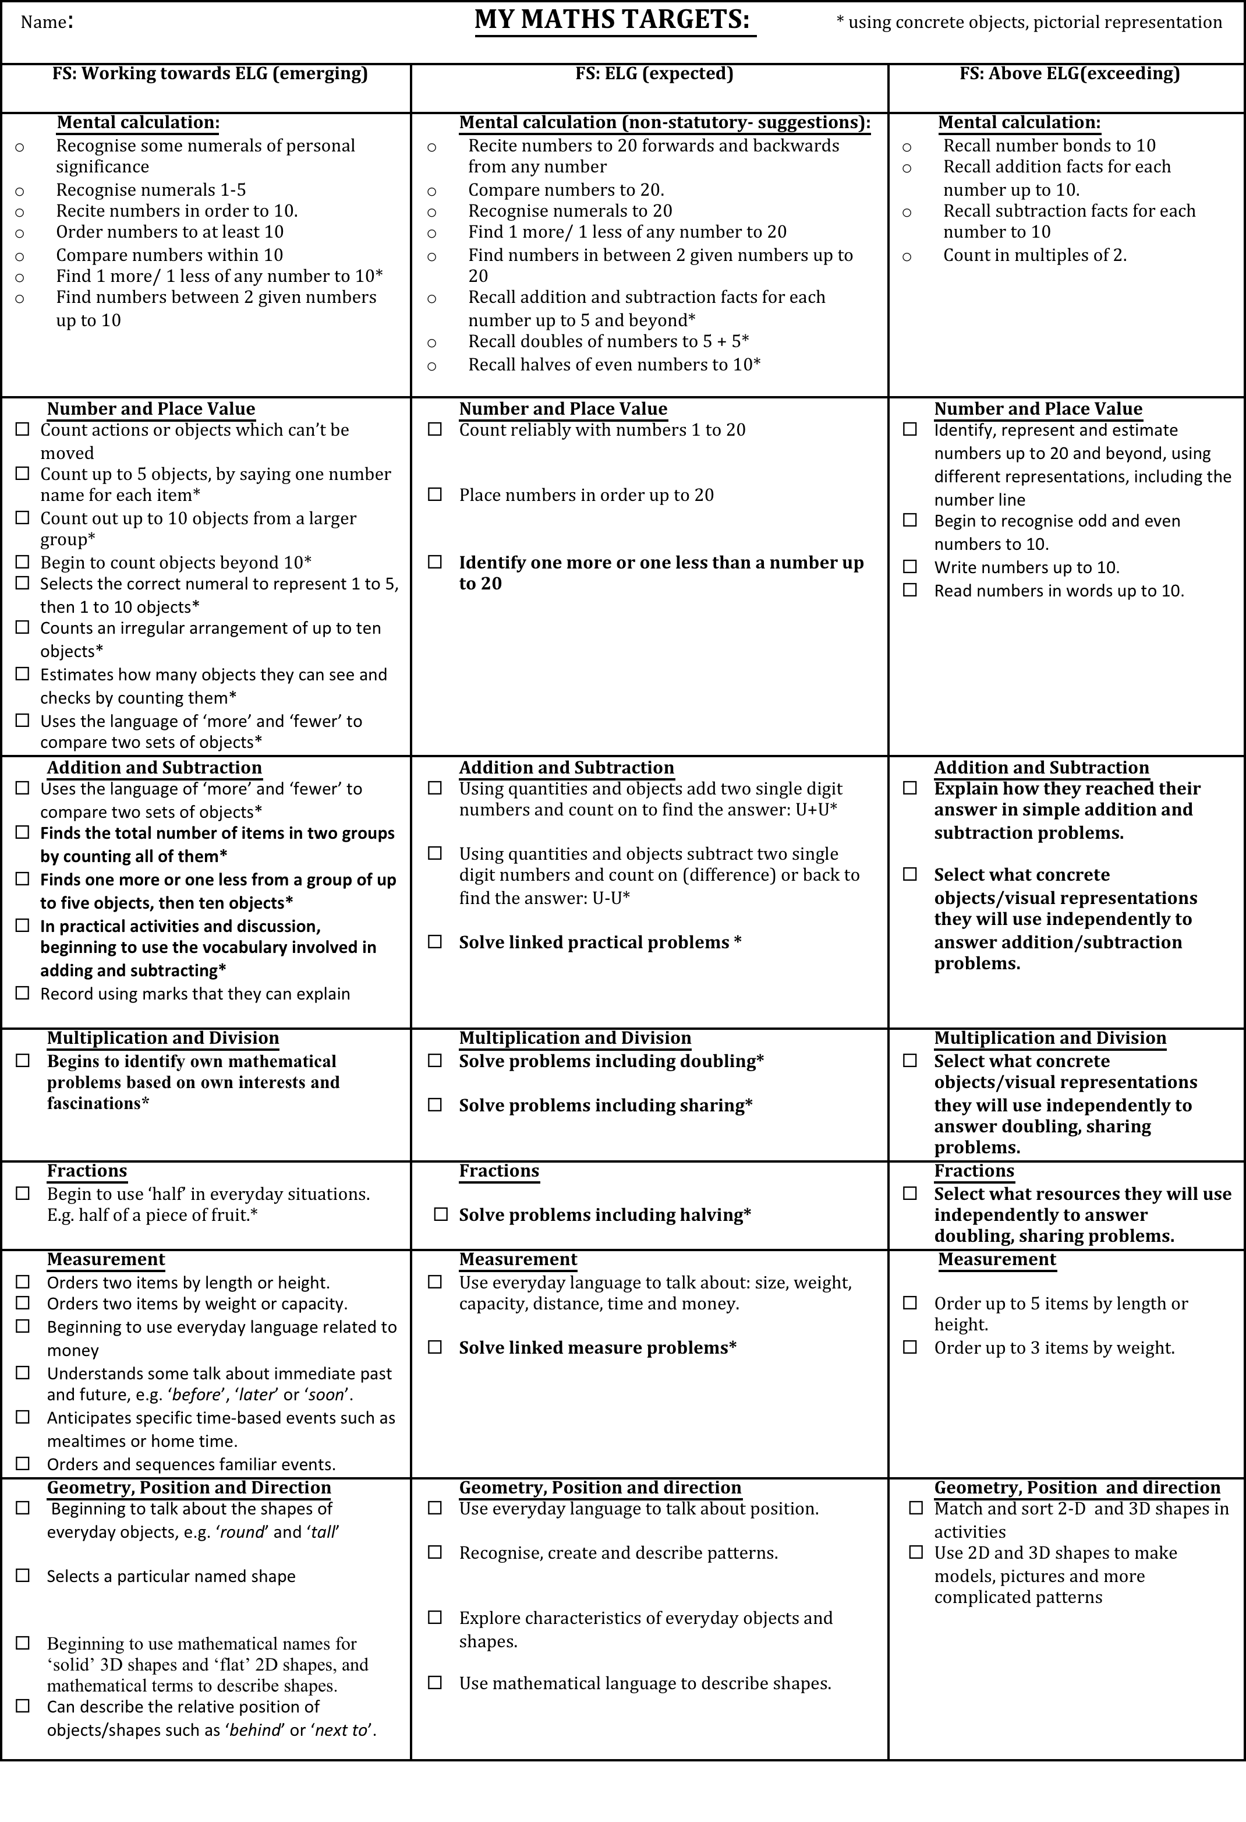
MATHS Assessment- Tracking& Target Sheets
At the end of the year teachers now have to report whether a child is at expected levels (middle column), emerging- working towards expected (first column) or working within greater depth-exceeding (last column). Some SEN children will be below POS (below emerging).
NB: Some significantly able children (previously called G&T) may be studying POS for the year above, but only after achieving all exceeding targets and solving linked reasoning investigations and problems.
National Aim is for 85% to be expected or higher.
Floor Target (minimum required by school) will raise to this level by the time Year 2 are in Year 6.

Slide 28
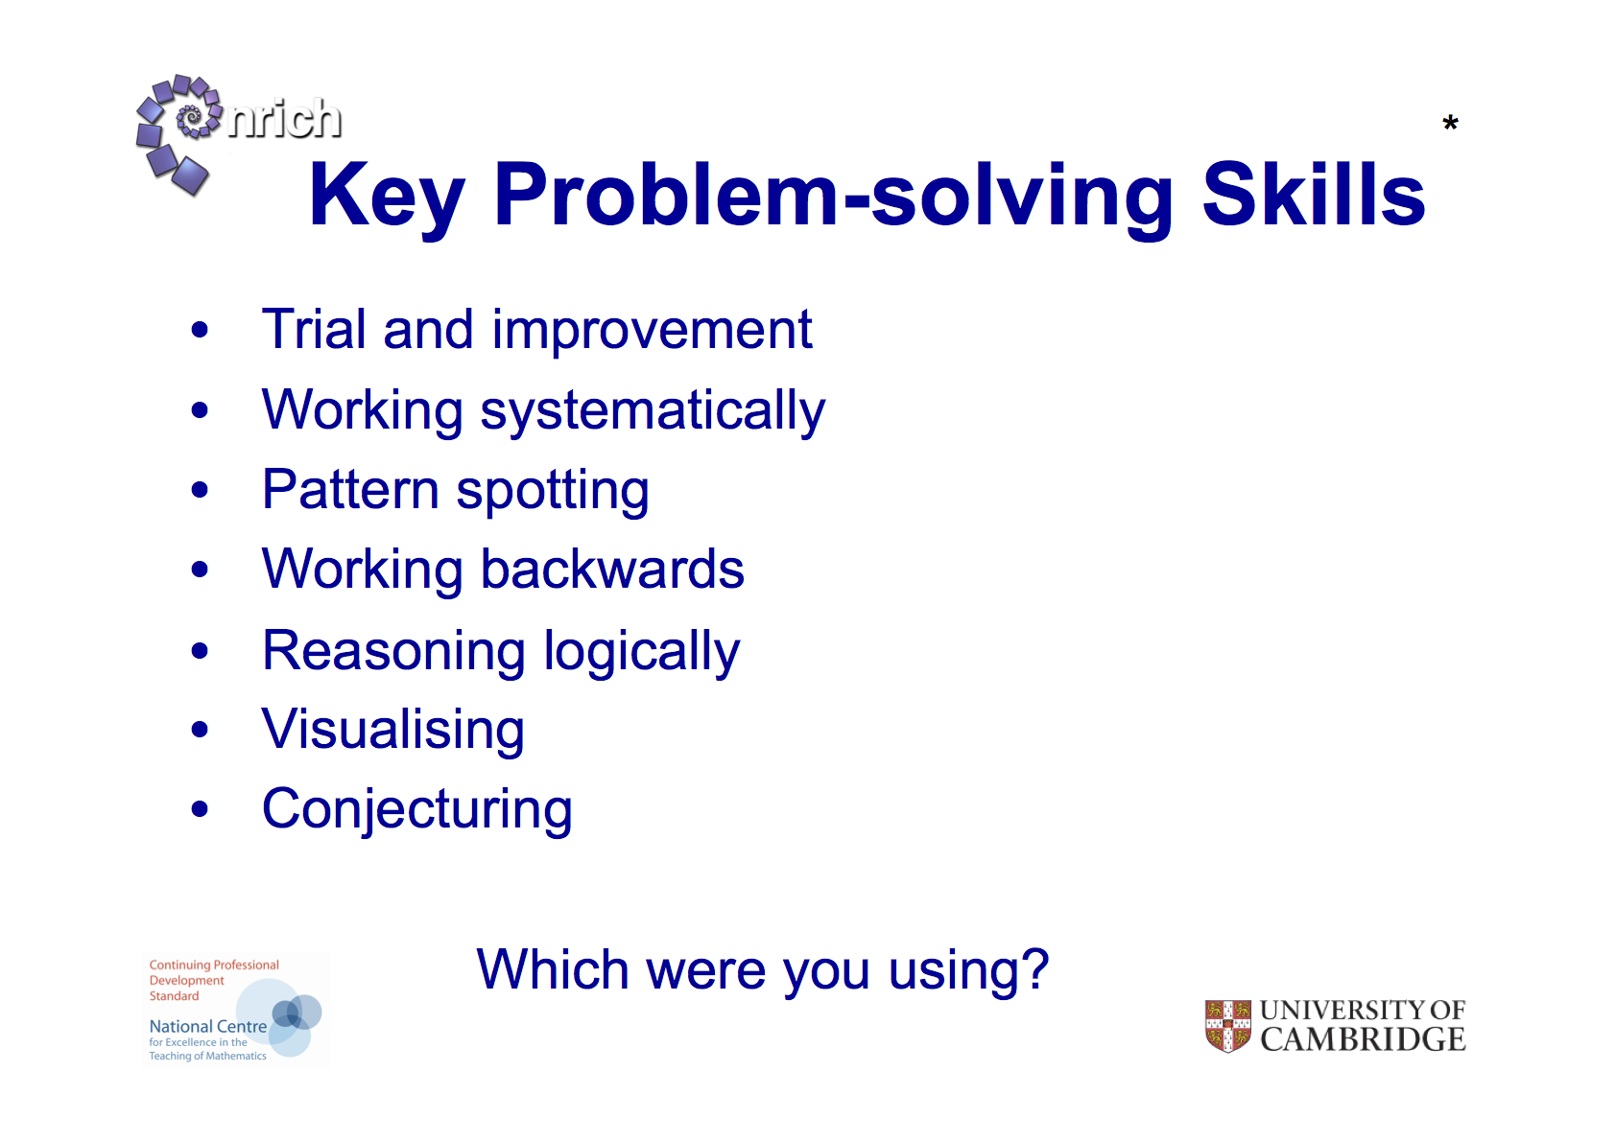
All children now need to develop and use these skills from FS onwards.

Slide 29
New IHS Calculation Policy and linked Manipulatives
Devised by Mrs Grasby and all IHS , staff to fulfil New Maths National Curriculum Requirements, Introduced September 2014
2013
DD Team
Notes:
29
Make sure staff have a copy of the NC aims etc as well as a copy of the pages relevant to their year group.
Staff who know they will be working with year 2 and year 6 will not need to start teaching the new POS until September 2015 but need to keep up to speed!

Slide 30
Which method should we use?
123
+123
450
+450
9.6
+ 1.2
7891 - 1235=
768.12 + 134.65=
4000
+ 5200
18-5=

Slide 31
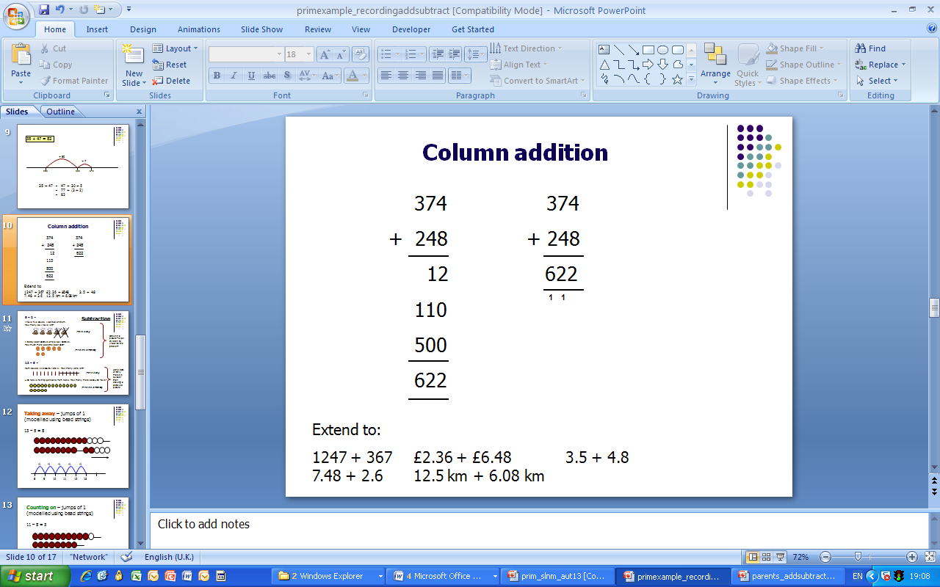
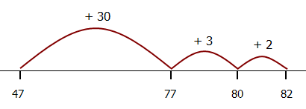
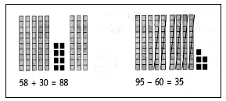
Addition: Yr3 onwards
Number line:47 + 35= 82 Columnar:
Base Ten :
Expanded
Vertical (used for selected children, if needed)
300 + 70 + 4
+200 + 40 + 8
600 + 110 + 12= 622
All children use base 10 and place value charts/ Numicon to introduce/support.

Slide 32
Addition: Yr4 onwards
Estimate (via rounding) and use inverse operations to check answers to a calculation.
Expanded vertical
(only LA/SEND)
789 + 642 = 1431
700 + 80 + 9
+600 + 40 + 2
1300 + 120 + 12= 1431
All children- concrete- use base 10 and place value charts to support.
COLUMNAR
24.90
+ 17.25
42.15
¹¹

Slide 33
Addition: Yr5/6 onwards
Partitioning and recombining:
Either partition both numbers and recombine or partition the second number only e.g.
35.8 + 7.3 = 35.8 + 7 + 0.3
= 42.8 + 0.3
= 43.1
COLUMNAR

Slide 34
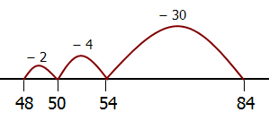
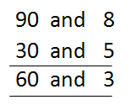
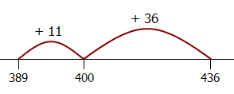
Subtraction: Yr2/3 onwards
Estimate answers and use inverse to check.

Slide 35
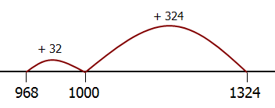
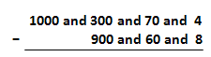
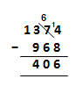
Subtraction- yr4 onwards

Slide 36
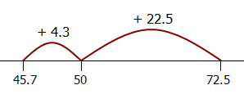
Yr5/ 6 onwards
72.5 – 45.7 = 26.8
Taking away
(no number line)
72.5 – 45.7
72.5 – 40 = 32.5
32.5 – 5 = 27.5
27.5 – 0.7 = 26.8

Slide 37
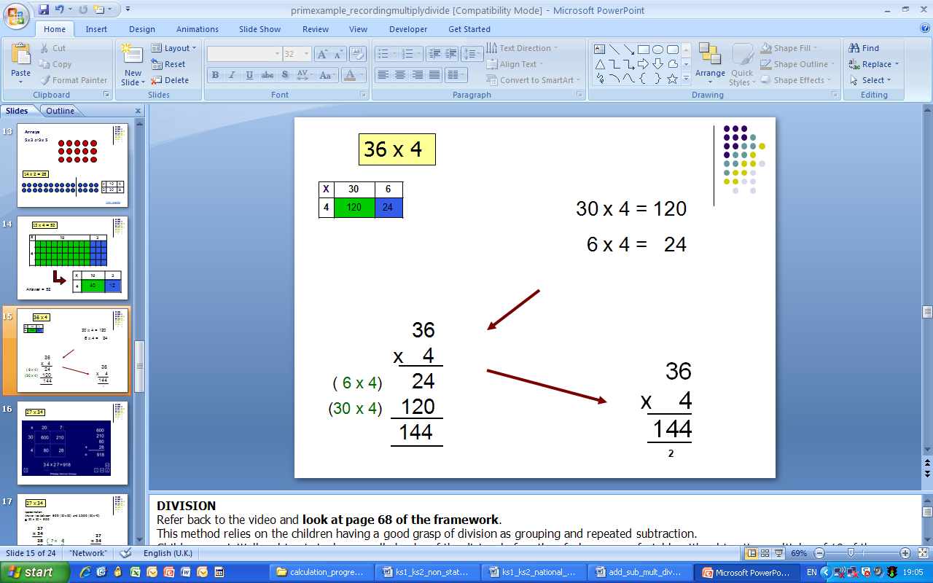
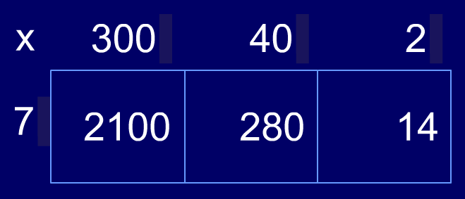
Multiplication: yr3/4 onwards
Grid Method:
Short multiplication (formal):

Slide 38
Multiplication: yr5/6 onwards
Grid Method:
Short multiplication (formal):
Long Multiplication
124 x 26 = 3224

Slide 39
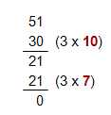
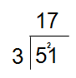
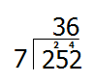
Division yr3/ 4 onwards
Written Chunking
Short Division:
Multiples of the divisor
252 ÷ 7 = 36
30 x 7 = 210
6 x 7 = 42

Slide 40
Division yr6
Long division:
25.6 ÷ 7 = 3.2
(estimate >3, <4)
Written (Chunking):
Short Division:
www.mathsisfun.com/long_division.html

Slide 41
NC 2014 Appendix of Written Methods
https://www.gov.uk/government/uploads/system/uploads/attachment_data/file/238967/Mathematics_Appendix_1.pdf

