Slide 1
Ide Hill C of E Primary School

Slide 2
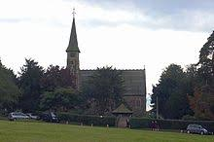
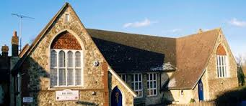
Where is Ide Hill School?
Our school is in a small village in Kent, England

Slide 3
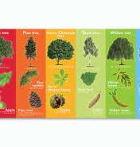
Our school
We have 6 classes named after British trees:
Oaks – Year 6
Ash – Year 4/5
Willows – Year 3/4
Beech – Year 2
Elms – Year 1
Saplings – YR
There are 143 children in our school.
Look at our website idehill.eschools.co.uk

Slide 4
Welcome

Slide 5
Our hall – we eat our lunches in here and have Collective Worship

Slide 6
Our playground – we do PE here and have playtime. We also have a large field to play on.

Slide 7
Our Library – do you like reading?

Slide 8
Oaks Classroom – we are the oldest children in the school

Slide 9
More from Ide Hill soon…

