Slide 1
Key Stage One Meeting September 2023-24
Adults in Key Stage One
Home learning
Routines and expectations
Behaviour
Key Dates
Questions
Welcome!

Slide 2
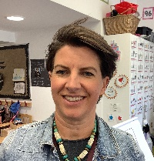
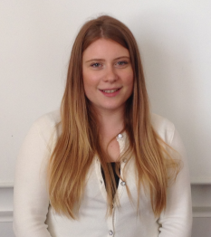
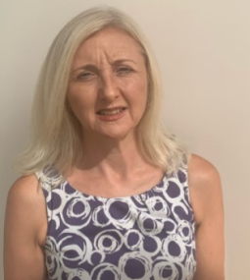
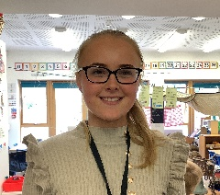
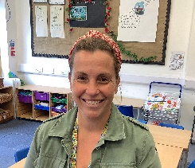
Elms
Adults in Key Stage One 2023-24
Mrs Farrar
Miss Rose
Mrs Rusling
Miss Bruce
Mrs Sandler
Mrs Marshall

Slide 3
Homework 2023-24
 | Daily Reading | Common exception words | Occasional maths/ art/ other activities | Spellings
Elms | ✓ | ✓ | ✓
Beech | ✓ | ✓ | ✓ | ✓

Slide 4
What homework can I expect?
Reading: Listening to your child is the most important homework you can do with your child in KS1. Expectations are 4x a week minimum. Chatting about the book before/ during/ after is really important to the children’s understanding and enjoyment of the story.
Common exception words: The children learn to read, and write, a set of CEW in each class. These are notoriously ‘tricky’ to master and need constant revision to make them ‘stick’ in the children’s long term memories. They may remember them on the day that they learn/ revise them, but may then spell them incorrectly when writing independently. We will be focusing on these words as part of their home learning.
Spellings in Beech: Children will receive weekly spellings to learn at home. They will contain a mixture of spelling patters, spelling exceptions, common exception words and high frequency words. Children will be tested each week, and it is important they feel prepared. To help these spellings 'stick' in their long-term memory they should be practiced across the week in a range of ways. At the end of each term, we will send home at random so spellings that have been taught across the term. It is useful to practice previous spellings randomly at home too.
Other activities: Children will, on other occasions, be given short maths/ art/ science activities to fit in with other topic areas.

Slide 5
How can I best support my child with their homework?
Try to pick a time where they aren’t too tired or hungry.
Try to be consistent about where or when you might complete a particular task e.g. reading their book after bath time.
Little and often is always better than trying to do everything in one go e.g. at the weekend.
Please stop if anyone is getting upset or frustrated and try to stay upbeat and positive, if possible!
Keep an eye on any letters or numbers you spot them reversing or forming incorrectly as these two things would be very useful for you to try and work with your child to correct.
Please don’t be tempted to correct their spellings (unless it’s a spelling task!) Writing is very difficult for children at this stage, and they might be proud of a piece until they are told there are mistakes. We are well practised in reading phonetic spellings!
Please encourage your child to use pencil for any written work.

Slide 6
Reading in Elms
Reading – A Key Skill
Reading Records will be checked by an adult in school at least once a week.
Children will continue to receive a Dojo for reading each night, as this has been working well.
Children will read with an adult in school for guided reading at least once a week. Here they will be taught comprehension and fluency skills.
In addition to our English lessons the children have a daily phonics session where they are taught to read (blend) and write (segment) words using the sounds taught using our scheme Rocket Phonics. This scheme is aligned to the reading books the children bring home.
Reading skills are also taught in our English lessons using, among other things, large ebooks which we read whole class.
Parent volunteer readers are encouraged, so please come and speak to us if you have any time to help out.

Slide 7
Reading in Beech
Reading – A Key Skill
It is expected that you read with your child every day. Remember to log what has been read in the reading record. Children can begin to do this for books they may have read at home too.
We expect children for 20 mins in Beech. Daily is best but at least 4 times per week is a minimum.
Reading Records will be checked by an adult in school each day.
Children will read with an adult in school for guided reading at least once a week. Here they will be taught comprehension and fluency skills.
The children are taught phonics ½ hour each day where they are taught to read (blend) and write (segment) words using the sounds taught using our scheme Rocket Phonics. This scheme is aligned to the reading books the children bring home.
Common Exception words are also taught during phonics sessions
Reading skills are also taught in our English lessons.

Slide 8
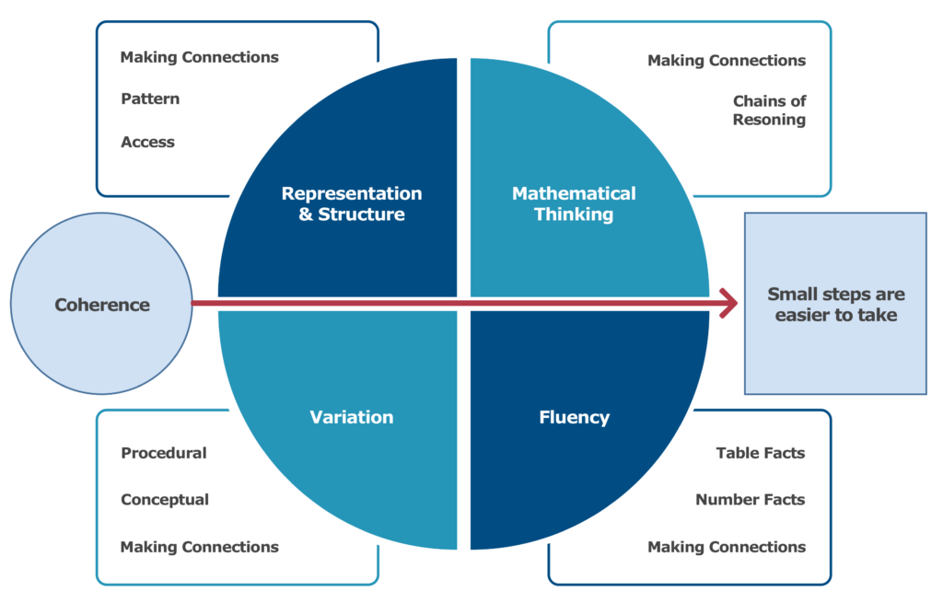
Maths in KS1
A Mastery Approach – Fluency, Reasoning and Problem Solving

Slide 9
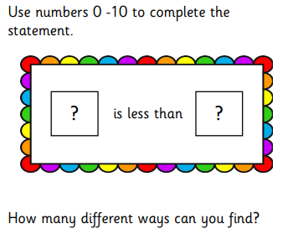
Maths in KS1
A Mastery Approach – Fluency, Reasoning and Problem Solving
What if the number less than has to be odd?
What if the number less than has to be even?
Can you do this systematically?
Can you do this using two number sentences ?

Slide 10
How is Year 1 different to Saplings?
More whole class teaching sessions. Each morning the children will have a phonics, English and Maths input. These are then followed by either group or whole class activity. By the end of the morning, usually all children will have completed all 3 tasks. Children not completing tasks will be accessing the provision available in class (SPLAT)
Independent learners. Children will mostly work with the support of adults, but will begin to complete learning tasks independently.
Different continuous provision in the classroom. The toys and activities which are available to the children are more suited to their age e.g. Lego and Brio
Enhanced provision targeted towards Year 1 learning objectives. Each week activities will be set up which will consolidate learning from the previous week.
More independence. We will encourage their independence in terms of changing their own book, getting their homework books out of their bags and getting their own jumpers and coats turned the right way around and put on with minimum help.
Responsibility. Each week we have 2 special helpers who run errands and help in class.
Rewards. We are collecting class Dojos and working towards achieving a ‘rainbow treat’. The children will choose this treat once we have reached the required number. The children will be awarded star certificates, which are awarded for going that extra mile within their learning. We also award house points.
Phonics Screening test in June. All children in the UK in Year 1 will been screened in phonics in the Summer term. The children will be given 40 words to read (20 real and 20 alien words) which will contain the sounds taught over the previous 2 years. We will prepare them for this within school.

Slide 11
How is Year 2 different to Year 1?
Longer whole class teaching sessions. Each morning the children will have a phonics, English and Maths input. These are then followed by whole class learning tasks.
Independent learners. Throughout the year children will require less support from adults to complete learning tasks by using the skills they have developed during their time in KS1. By the end of the year most children will be working independently.
Different continuous provision in the classroom. The toys and activities which are available to the children are more suited to their age e.g. knex, clay, only offering primary colours. Enhancements will be set up which will consolidate or introduce new learning. Children will be taught how to deepen and extend their own play through becoming more independent and critical thinkers. As the year develops, children will spend less time accessing the provision ready for the transition into KS2.
More independence. We expect children to be experts at changing their own book, getting their homework books out of their bags and getting their own jumpers and coats turned the right way around without help or reminders.
Responsibility. Children are responsible for their own success in class by demonstrating thoughtful choices. This could include asking for help, asking questions, remembering expectations of routine and behaviour and working towards their identified areas progress.
Rewards. We are collecting class and individual stars working towards achieving ‘golden time’. The children will choose this treat once we have reached the required number. The children will be awarded star certificates, which are awarded for going that extra mile within their learning. Children are also awarded housepoints.
End of KS1 Assessment (SATS). All children in the UK in Year 2 will be assessed at the end of the year in reading and maths. You do not need to prepare for this in anyway at home. This is not an assessment of individual children's abilities, rather what they have learnt over their time in KS1. The test environment is very relaxed. Children can have as many breaks as they like and we usually take a full week to complete all papers.

Slide 12
Curriculum Changes
Last year we changed our curriculum from a 'topic' based to 'skills based' curriculum
We have selected fabulous schemes to support our teaching in each subject
Allows for in depth subject specific lessons
Each year groups plans are on the school website for anyone wanting more details

Slide 13
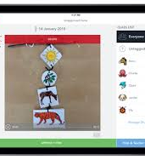
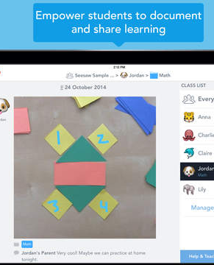
Seesaw learning platform
Amazing resource for children to record their learning using pictures, notes, voice recordings
Learning and photos will be shared with parents at various points in the year.

Slide 14
Expectations for Parents 2023-24
If you have a concern or news you want to share:
-We are here to help: In the first instance, always discuss your child or your concerns with their class teacher. If you need more than a quick chat, please book an appointment via the school office.
-Following meeting with your child’s teacher, if you feel you need to seek further support. Our Headteacher, Mrs Hillman is available to support parents too. Please arrange a meeting with her if you feel further support is needed
-If parents have a concern about special educational learning, first speak to your class teacher, and then our SENCO and Inclusion Manager, Mrs Rees.
-Further support can be sought from governors after these meetings if needed.

Slide 15
Expectations for Behaviour 2023-24
We have high expectations of behaviour and we will expect your child to follow the School Rules. The children have:
A right to learn
A responsibility to try to do the best that they can.
A right to be safe and cared for
A responsibility to look after each other
A right to play
A responsibility to include others
A right to be respected
A responsibility to listen, to speak politely and to be honest.

Slide 16
Expectations for Behaviour for Learning 2023-24
Reward is the best motivation for learning
Children are expected to stay on ‘green’ –
Children will be given house points/ Dojos for small achievements such as doing their best, listening well, helping a teacher, completing tasks well and so on.
Children will be rewarded by being moved on the behaviour chart to ‘the star’ if they have gone ‘over and above’ expectations – they will receive a class certificate to bring home–
Personal achievements recognised in certificates given out in assembly.

Slide 17
Expectations for Behaviour for Learning 2023-24
We have high expectations of behaviour and we will expect your child to follow the School and class rules.
Children who do not show the appropriate behaviour will be given a warning – and asked to change their behaviour
Children continuing or showing other additional inappropriate behaviour will be given an Amber card which will be recorded in the School Behaviour book and 5 minutes of the following morning playtime will be missed in the time out room with a teacher.
Children continuing or showing other additional inappropriate behaviour will be given a Red card which will be recorded in the School Behaviour book and parents will be informed. Children will miss their next morning break.
Continual Red cards will require further action to be discussed with parents.
Each day starts on Green!

Slide 18
Please provide your child with:
Water bottle – clear and named
A named coat
Reading folder- preferably no rucksacks in KS1
Reading Record and reading book in school every day please
There is no need to bring in personal equipment like pencil cases or toys
Please only buy lace up shoes if your children can lace up their own shoes. This included PE trainers!!
PE Kits to be worn on PE days
ELMS Monday and Thursday
BEECH Monday and Wednesday
Routines and Expectations 2023-24

Slide 19
Thank You!
We are in a partnership to educate your child
Your support is vital and appreciated – please volunteer if you can!
Please let us know early if you have any concerns
Please bear with us – there are many children but they are all important to us!

